Slide 1
Senior Research Paper
Are you excited about your topic?

Slide 2
Bibliography/Source/Bib Card
A 3” x 5” index card
Source you will use in your research product
Information for your Works Cited page
Proof of the research you have completed
Organized alphabetically by first keyword in the source card citation

Slide 3
Bibliography/Source/Bib Card
Library – where received information
Call Number (only if a book)
-----------------------------------------------------------------------------------------------------
Source written according to most current MLA handbook.
(begin on 2nd blue line)

Slide 4
Bibliography/Source/Bib Card
NMHS
-----------------------------------------------------------------------------------------------------
Smith, Robert. “Lincoln, Abraham.” Encyclopedia Americana. 2004. Grolier Online. Foster High School Library, Richmond, TX. 28 Sept. 2005 <http://eagrolier.com/>.
½ inch hanging indent
For each type of bib/source card, refer to MLA handbook for format.
(See enlarged version in sample section.)

Slide 5
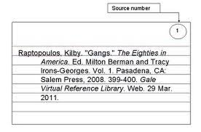
Example Source Card
Notice how only the first line is out dented
Notice that all additional lines
Are indented

